Slide 1
Elasticsearch
By: Kumar, Rajnish

Slide 2
What is Elasticsearch?
❏ Elasticsearch is a great tool for document indexing and powerful full text search
used for Big Data Analytics.
❏ It’s JSON based Domain Specific query Language is simple and powerful, making it
the defacto standard for search integration in any web app.
❏ The combination of storage and querying / aggregation services makes
elasticsearch really special and distant from the “document storage only” tools.

Slide 3
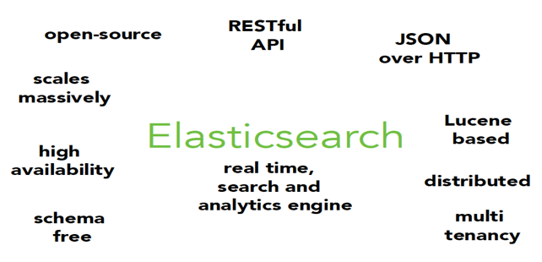
Elasticsearch (Cont..)

Slide 4
When to use Elasticsearch?
❏ Searching text and structured data (product search by name + properties)
❏ Data Integration
❏ Geo Search
❏ JSON document storage

Slide 5
Basic Concepts used in Elasticsearch
❏ Cluster: A set of Nodes (servers) that holds all the data
❏ Node: A single server that holds some data and participate on the cluster’s indexing
and querying
❏ Index: Forget SQL Indexes. Each ES Index is a set of Documents.
❏ Shards: A subset of Documents of an Index.
❏ Document: A JSON Object with some data.

Slide 6
Elasticsearch for Big Data Analytics
Three reasons:
❏ It is very easy to get a toy instance of Elasticsearch running with a small sample
dataset.
❏ Elasticsearch JSON based query language is much easier to master than more
complex systems like Hadoop’s MapReduce.
❏ Application developers are more comfortable maintaining a second Elasticsearch
integration over a completely new technology stack like Hadoop.

Slide 7
Elasticsearch Setup
❏ Step 1: Check Java Version
❏ Step 2: Download from www.elasticsearch.co
❏ Step 3: Installation: $ bin/./elasticsearch

Slide 8
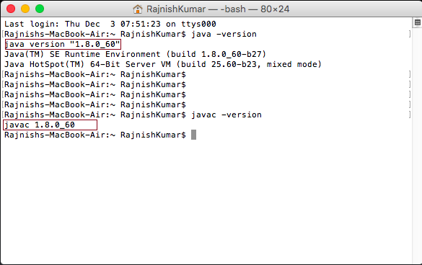
Elasticsearch Setup (Cont.)
❏ Step 1: Check Java Version (Make sure java version should > 1.6)

Slide 9
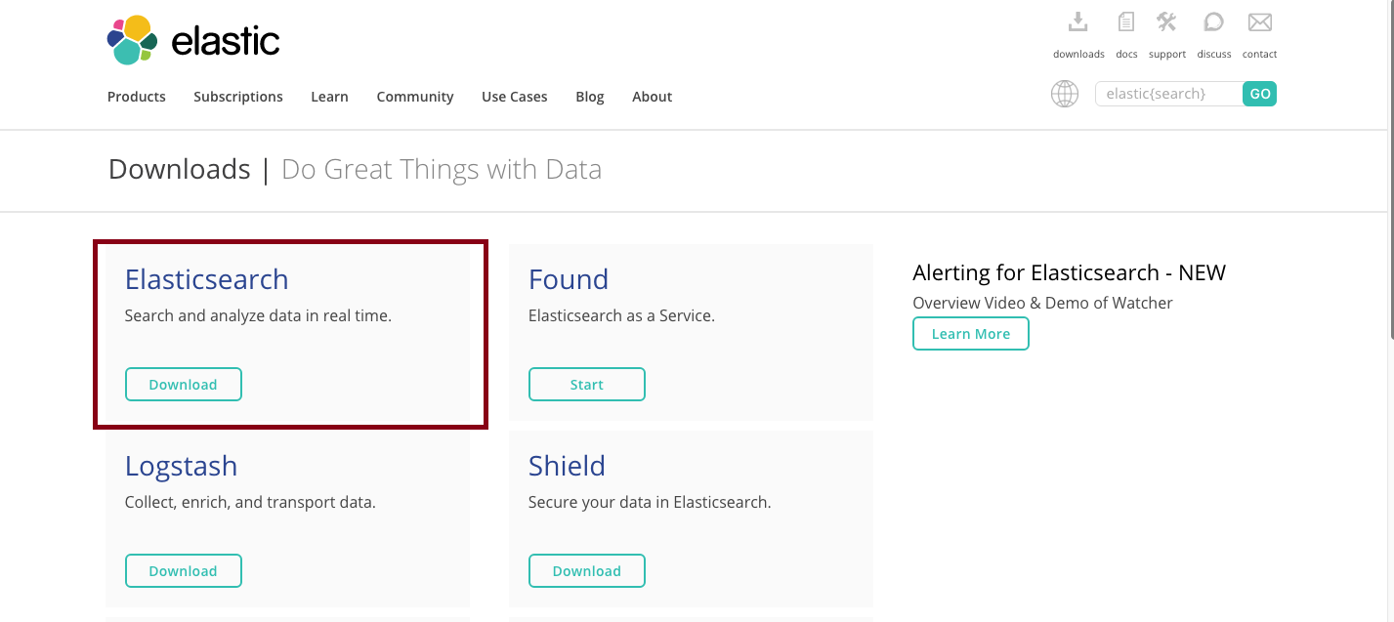
Elasticsearch Setup (Cont.)
❏ Step 2: Download from www.elasticsearch.co

Slide 10
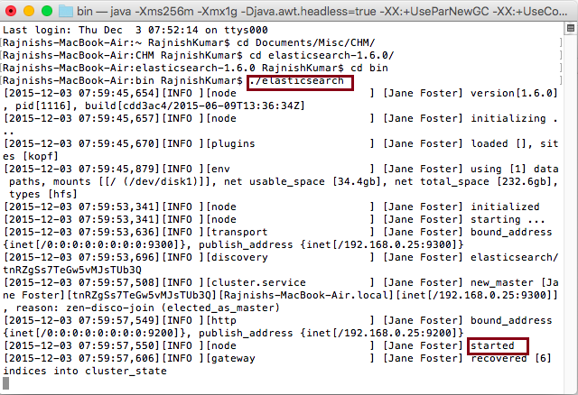
Elasticsearch Setup (Cont.)
❏ Step 3: Installation: $ bin/./elasticsearch

Slide 11
ES Configuration
❏ Each Physical server has minimum 1 master node and 3 data nodes.
❏ Each node is configured to make use of pointer compression
❏ Lock all memory to prevent ES memory from being swapped cut
❏ Max file descriptors = 32k for user that run ES
❏ Node discovery using unicast

Slide 12
ES Index Configuration
❏ Mapping
❏ Templates
❏ Temporal indexes
❏ Aliases

Slide 13
Indexing and Querying
❏ Rest API: Elasticsearch uses a Rest API for searching and storing documents.
$ curl -XPUT 'http://localhost:9200’ -d '{
"author": “rajnish",
"tags": ["java", "web"],
"title": “cin",
"context": ”Pvt. Ltd."
}'
❏ Indexing: creates some internal data structures that makes the query perform better.
❏ Querying: Based on coordinates, numeric range queries that is used to aggregate data

Slide 14
Kopf
Kopf is a plugin which is used for elasticsearch.
It is generally used for large clusters.
It offers filters in Nodes by Name and type, indexes by Name and type.
Kopf provides access a lots of elasticsearch API features.
It also provides standardization and optimization.
It hides special indexes created internally by elasticsearch.
It offers a JSON Editor for RESTful services.
We can retrieve information from the json object.

Slide 15
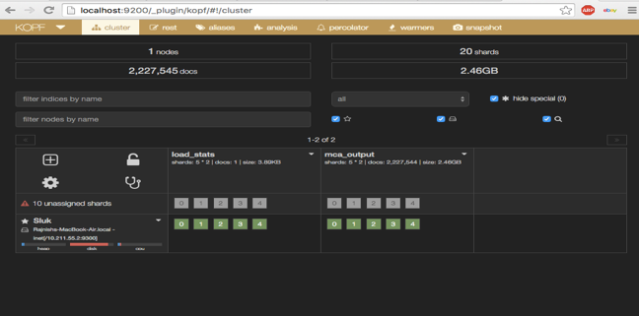
Kopf (Cont..)

Slide 16
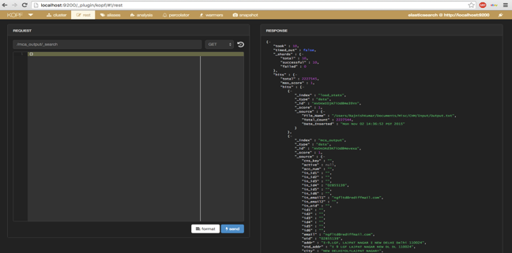
Kopf (Cont..)

Slide 17
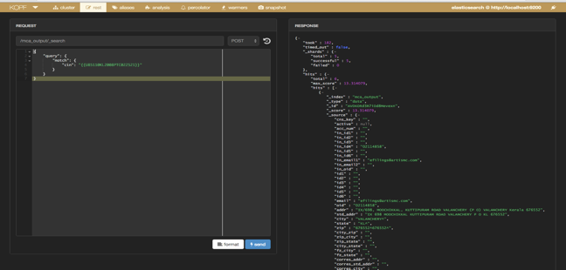
Kopf (Cont..)

Slide 18
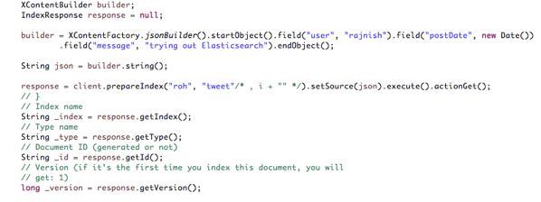
creating index and establishing connection
Building index

Slide 19
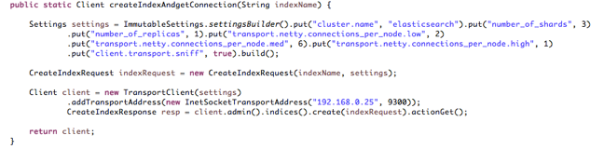
creating index and establishing connection (Cont..)
Creating Index and setting with connection:

Slide 20
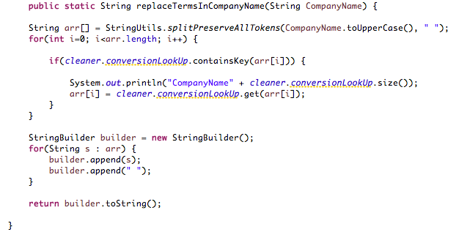
Replacement Standardization

Slide 21
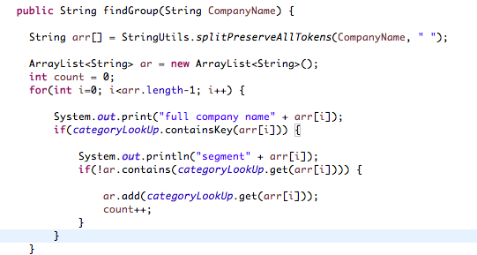
Group Standardization

Slide 22
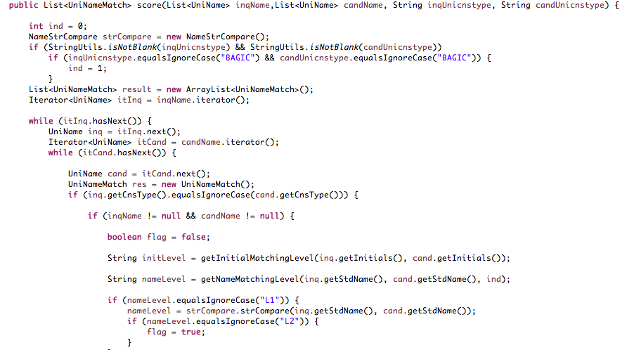
Name Standardization

Slide 23
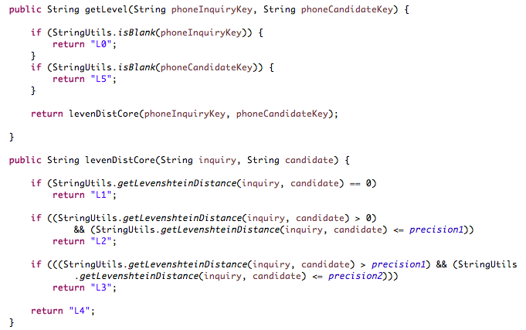
Phone Standardization

Slide 24
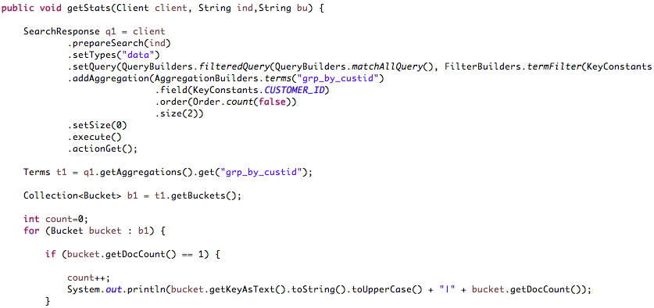
Duplicate Standardization

Slide 25
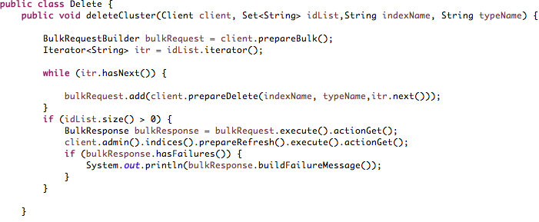
Delete Standardization

Slide 26
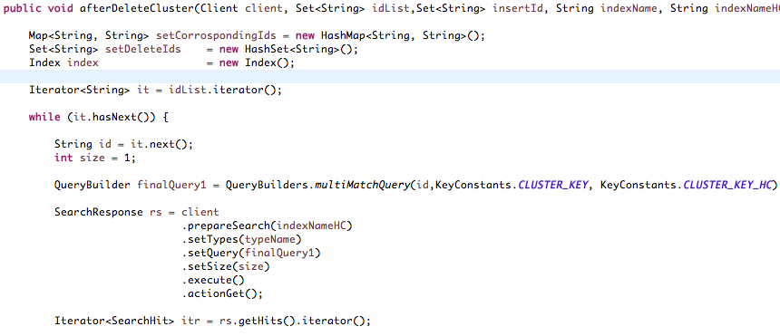
Cluster Formation after Delete

Slide 27
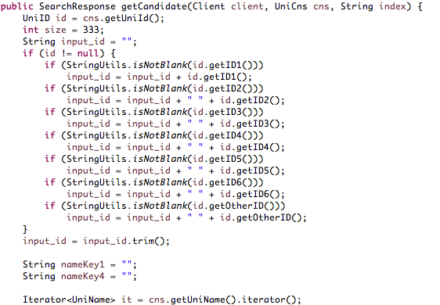
Fetching candidate Value

Slide 28
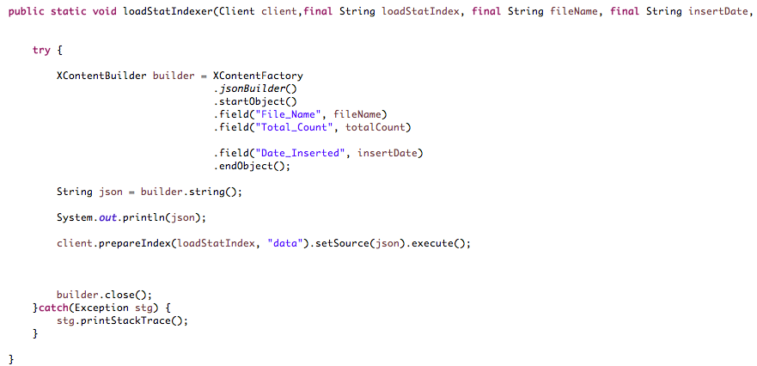
Loading Index in Cluster

Slide 29

Who is using Elasticsearch?

Slide 30
Advantages of Elasticsearch
❏ Fast, Incisive Search against Large Volumes of Data
❏ Indexing Documents to the repository
❏ Denormalized Document Storage
❏ Broadly Distributed and Highly Scalable

Slide 31
Thank You

